Slide 1
Detecting Common Coupling
Ronaldo Goncalves Junior, Sungsoo Ahn, Bennilyn Quek

Slide 2
Common Coupling
Global Coupling
2 modules associated to same global data
e.g., usage of a global variable
Change to data imply changes to all modules using it
Java - What is a global variable?
public static variable (strong)
protected static variable (weak)

Slide 3
Out of Project Scope
Data Coupling
Modules share data through parameters
Stamp Coupling (Data-Structured)
Modules share a composite data structure without knowing parts used by other
Control Coupling
A module control the logic of another
External Coupling
2 modules share externally imposed data format, communication protocol, or device interface
Content Coupling
A module modifies/relies on internal workings of another module

Slide 4
Methods, tools, and techniques
Programming language: Java
Detection Approaches:
Eclipse JDT/AST
srcML
System: Apache OpenNLP
Machine learning based toolkit for processing natural language text
Over 1k files (640+ java files)
Certain degree of common coupling (contains global variables)
Notes:
Grep -r
Open NLP
605 files, 20% global variable

Slide 5
Deliverables & Milestones
April 12
Interim project presentation.
Revised schedule.
Manual test.
April 14
Prototype
Interim report document (paper and electronic form)
April 26
Implementation
Validation
Final project presentation
May 3
Final project report (paper and electronic form)

Slide 6
Approach Using Eclipse JDT/AST
For each class (java file) within the system
Search for FieldDeclaration with static modifier
Identify usage (read and write) in other classes of the system
Manage the coupling degree
Register the number of classes coupled (common coupling)
Store the results in a text file
Notes:
SrcML
Look for tags field declaration, estrack modifiers if contain static

Slide 7
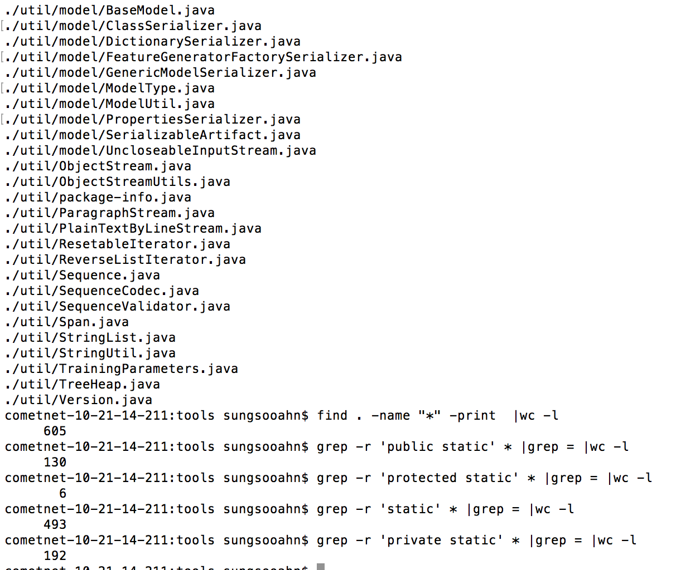

Slide 8
References
Wikipedia. Coupling (computer programming). Accessed on: March, 29. Available at: <https://en.wikipedia.org/wiki/Coupling_(computer_programming)>.
Wikipedia. Global variable. Accessed on: March, 29. Available at: <https://en.wikipedia.org/wiki/Global_variable>.
Boukari Souley and Baba Bata. A Class Coupling Analyzer for Java Programs. West African Journal of Industrial and Academic Research Vol.7 No. 1 June 2013.
Michel Chaudron. Design Heuristics and Architectural Styles (LL Chapter 9). Accessed on: April, 5. Available at: <https://rickvanderzwet.nl/trac/personal/export/3/liacs/se/slides/09_Design_Heuristics_and_Styles_part2.pdf>.

